Slide 1
Narendra Kumar Charugundla

Slide 2
Agenda
Introduction to Node JS
How to Install
Simple Examples
NPM
Q & A

Slide 3
What is node.js
Node.js or Node is a open source cross platform and JavaScript runtime built on Chrome's V8 JavaScript engine
Node is run time environment for executing Java script code outside of a browser.
Node JS quite often use Node to build back-end services or API(Application Programming Interface).
Node.js uses an event-driven, non-blocking I/O model that makes it lightweight and efficient.
Node’s goal is to provide an easy way to build highly scalable network programs, data-intensive and real time apps.

Slide 4
node.js BACKGROUND
V8 is an opensource JavaScript engine developed by Google. It’s Written in C++ and is used in Google Chrome Browser.
Node.js runs on V8.
It was created by Ryan Dahl in 2009.
It was open source and cross platform It runs well on Linux Systems. Can also run-on windows systems.
In simple words Node.js is ‘server-side JavaScript’.
It’s not so simple words Node.js is a high-performance network applications framework. well optimized for high concurrent environments.
In Node.js, ‘.js’ does not mean that it’s solely written Java script. It is 40% JS and 60% C++.
Node is NOT a programming Language and Node is not a framework. It won’t compare any backend framework like Spring,ASP.net, ruby rails etc
Notes:
Browser’s Based Java script Engines:
Microsoft Internet Explorer- Chakra
Firefox browser-Spider Monkey
Google Chrome-V8

Slide 5
Advantages of node js
Great for prototyping and agile development.
Superfast and highly scalable
Using Node APP, Company’s achieve below highlighted options
Build twice as fast with fewer people
33% fewer lines of code
40% fewer files
2x request/sec
35% faster response time.
JavaScript everywhere
Cleaner and more consistent codebase.
Larger ecosystem of open-source libs.

Slide 6
How Node.JS Works?
Asynchronous and Event Driven – many connections can be handled concurrently
Node.js uses an event-driven, non-blocking I/O model which makes it’s lightweight.
It makes uses of event-loops via java script’s callback functionality to implement the non-blocking I/O.
Lightweight and Very Fast
Programs for Node.js are written in java script but not in the same JavaScript we are use to. There is no DOM implementation provided by Node.js i.e. you can do this:
Var element=document.getElementId(“element”);
Everything inside Node.js runs in a single thread.

Slide 7
Where all NODE.js
I/O bound Applications
Data Streaming Applications
JSON APIs based Applications
Note - It is not advisable to use Node.js for CPU intensive applications.

Slide 8
When to USE NODE JS
Node.js is good for creating streaming based real-time services, web chat applications, static file servers etc.
If you need high level concurrency and not worried about CPU-cycles.
If you great at writing Java script code because you can use the same language at both places : server-side and client-side.

Slide 9
When to NOT USE NODE JS
When you are doing heavy and CPU intensive calculations on server side, because event-loops are CPU hungry.
Node.js is a no match for enterprise level applications like Spring(Java),Django(python),symtony(php) etc.
Applications written on such platforms are meant to be highly user interactive and involve complex business logic

Slide 10
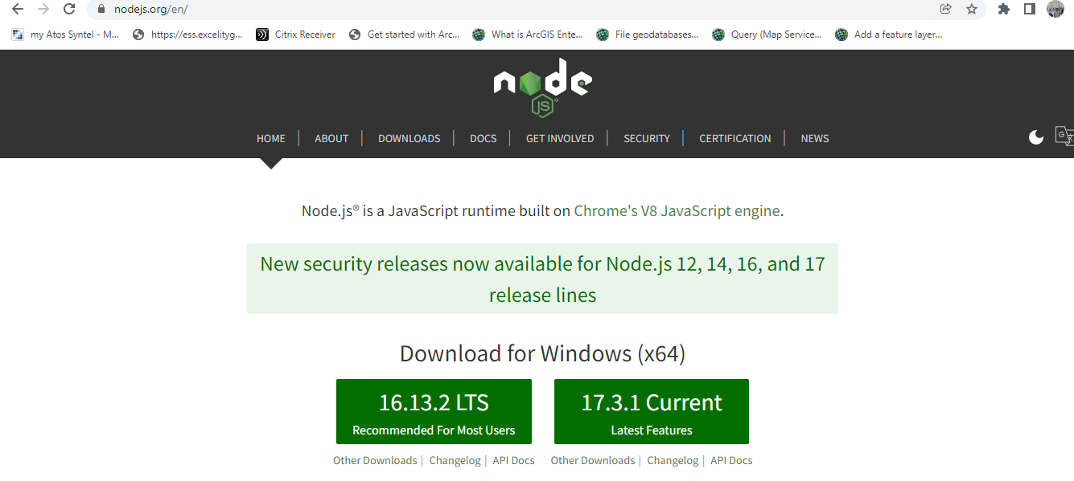
How to install NodeJS
Download latest nodejs.exe from - https://nodejs.org/en/
Execute the exe

Slide 11
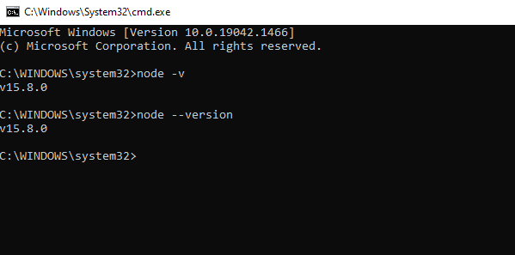
Validate NodeJS installation
Command prompt, node --version

Slide 12
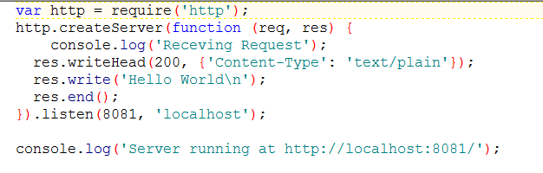
Hello WorLD

Slide 13
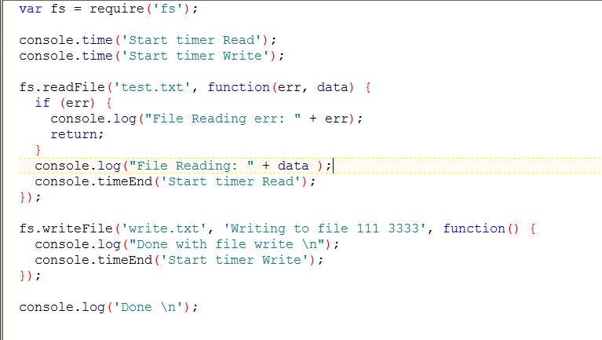
Async I/O

Slide 14
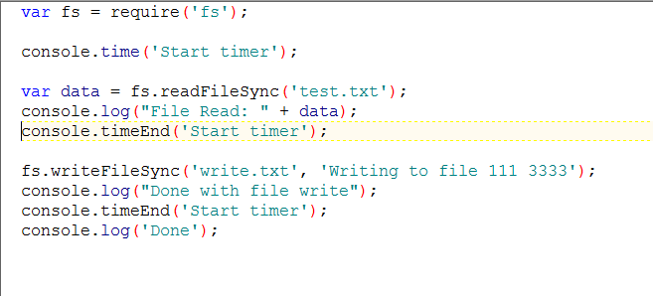
sync I/O

Slide 15
NODE Package manager (npm)
Node.js supports modularity. Each modules can be bundled under a single package.
NPM is used to install, update, uninstall and configure Node JS Platform modules/packages very easily.
Node.js heavily relies on modules, require keyword loaded the http & net modules.
Creating a module is easy, just put your java script code in a separate js file and include it in your code by using keyword require like this
Var module= required(‘./module’);
Libraries in Node .js are called packages and they can be installed by typing
Npm install “package Name”;// package should be available in npm registry & npmjs.org.
NPM (Node Package Manager) comes bundled with Node JS Installation

Slide 16
Installing third party modules
NPM Install
npm install <options> <package unique name>
Eg - npm install express --save

Slide 17
Node.js “require”
The modules/packages available can be imported in .js file using “require” function.
Ex – require(“http”);
This helps in loading “http” package in current .js file.

Slide 18
Modules export n import
A module in node.js can be exported, by which it can be imported in other files.
The “require” function helps in importing modules.
Exporting -
module.exports{<module to be exported>}
Importing –
var <varName> = require(<module name>);

Slide 19
References
https://nodejs.org/en/
http://www.journaldev.com/7462/node-js-architecture-single-threaded-event-loop
https://www.npmjs.com
https://nodejs.dev/learn/differences-between-nodejs-and-the-browser
https://nodejs.dev/learn/introduction-to-nodejs
https://codeforgeek.com/node-js-tutorial-step-by-step/
https://www.tutorialspoint.com/nodejs/nodejs_repl_terminal.htm
https://www.w3schools.com/js/js_es6.asp

Slide 20


Slide 21


